Slide 1
Chapter 2
Process
Mohammed Arfat
International Islamic University Chittagong

Slide 2
What is process?
A process is a program in execution.
What is process management?
The activities involved in managing the execution of multiple processes in an
operating system

Slide 3
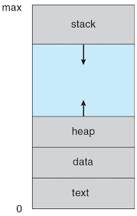
Layout of a process in memory:
Stack: The stack contains temporary data, such as function parameters, returns addresses, and local variables.
Heap Section: Dynamically Memory to process during its run time
Data Section: Contains the global variable.
Text Section: The executable code

Slide 4
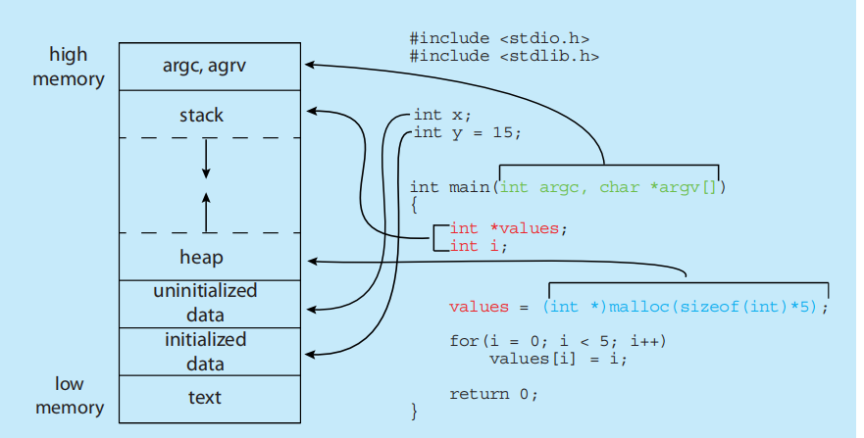

Slide 5
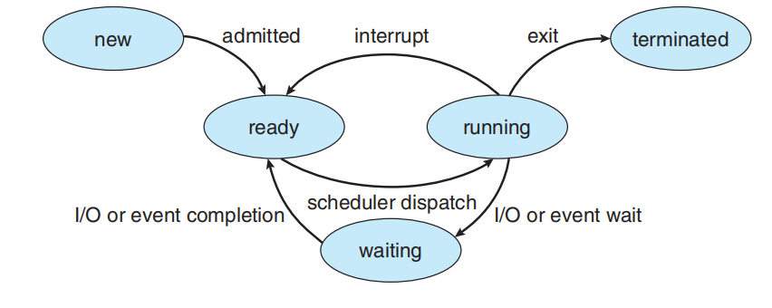
Five-state model:
New: The process is being created.
Running:Instructions are being executed.
Waiting: The process is waiting for some event to
occur (such as an I/O completion or reception of
signal).
Ready: The process is waiting to be assigned to a
processor
Terminated:The process has finished execution.

Slide 6
What is Process Scheduling
Process Scheduling is an OS task that schedules processes of different states like ready, waiting, and running.
Type of Process Schedulers
There are mainly three types of Process Schedulers:
Long Term Scheduler:New to ready
Short Term Scheduler:ready To Running
Medium Term Scheduler: It is responsible for
suspending and resuming the process.
It mainly does swapping (moving
processes from main memory to disk
and vice versa)

Slide 7

Context Switch:

Slide 8
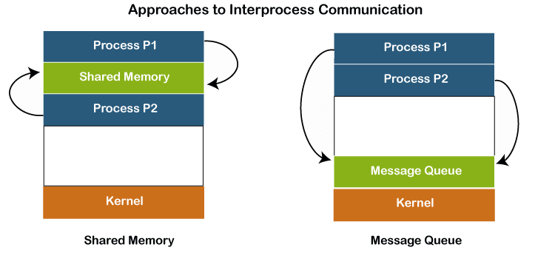
Interprocess Communication
1.Independent process
2.cooperating Process

Slide 9
IPC in Message-Passing Systems
Naming
• send(P, message)—Send a message to process P.
• receive(Q, message)—Receive a message from process Q.
Synchronization
• Blocking send. The sending process is blocked until the message is
received by the receiving process or by the mailbox.
• Nonblocking send. The sending process sends the message and
resumes operation.
• Blocking receive. The receiver blocks until a message is available.
• Nonblocking receive. The receiver retrieves either a valid message or a
null.

Slide 10
Buffering
Zero capacity: The queue has a maximum length of zero;
Bounded capacity: The queue has finite length n; thus, at most n
messages can reside in it .
Unbounded capacity: The queue’s length is potentially infinite; thus, any
number of messages can wait in it. The sender never
blocks.

Slide 11
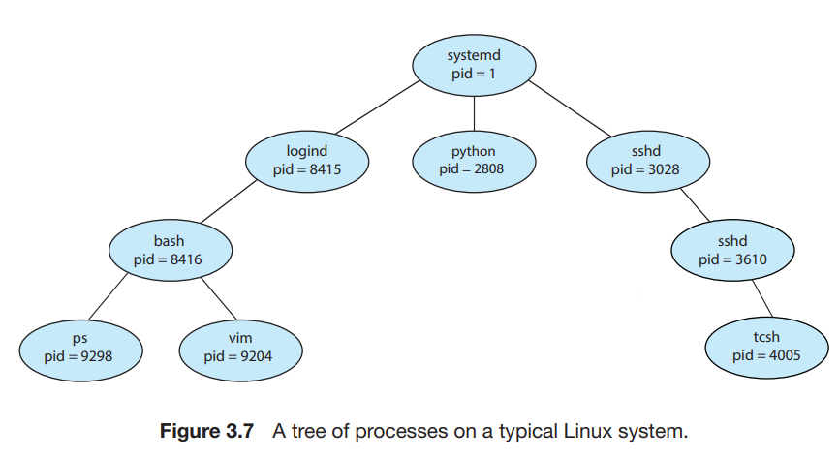
Operations on Processes
Process Creation

Slide 12
Process Termination
The child has exceeded its usage of some of the resources that it has been allocated. (To determine whether this has occurred, the parent must have a mechanism to inspect the state of its children.)
• The task assigned to the child is no longer required.
• The parent is exiting, and the operating system does not allow a
child to continue if its parent terminates.
/* exit with status 1 */
exit(1);

Slide 13
**Parent may terminate the execution of children process using the abort() system call.
** If a process terminates ,then all its childrfen must be terminated.This problem is called Cascading Termination.
A parent process may wait for the termination of a child process by using the wait() system call. The wait() system call is passed a parameter that allows the parent to obtain the exit status of the child. This system call also returns the process identifier of the terminated child so that the parent can tell which of its children has terminated:
pid t pid;
int status;
pid = wait(&status);
If no parent waiting (did not invoke wait()) process is a zombie
If parent terminated without invoking wait , process is an orphan

Slide 14
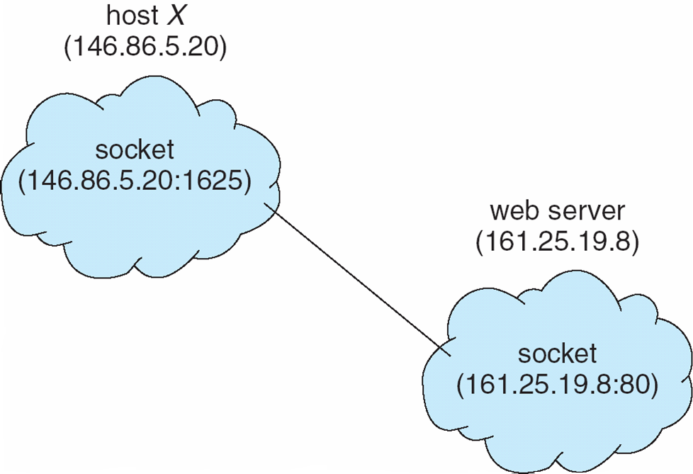
Communication in Client–Server Systems
Sockets
Remote Procedure Calls
Pipes
Remote Method Invocation (Java)
Sockets
Asocket is defined as an endpoint for communication
Communication using sockets

Slide 15
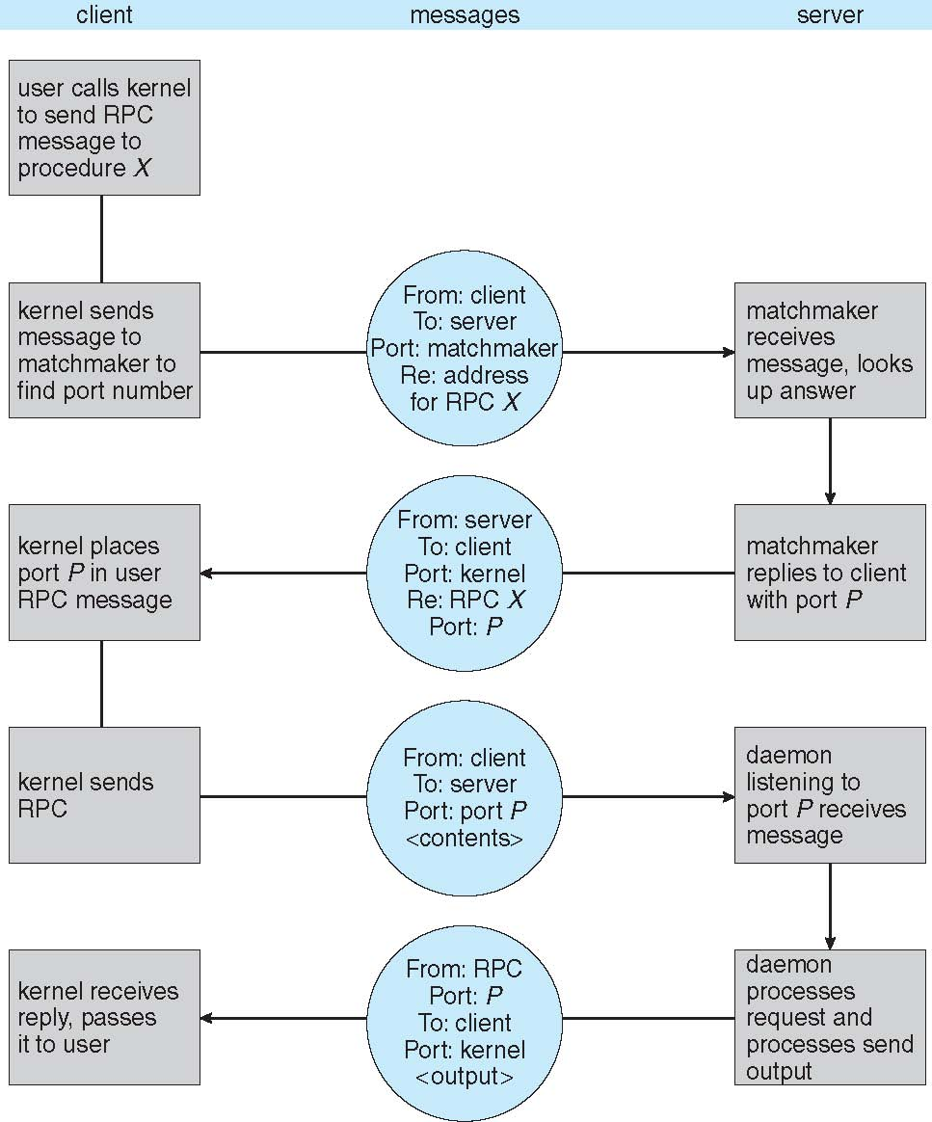
Remote Procedure Calls

Slide 16
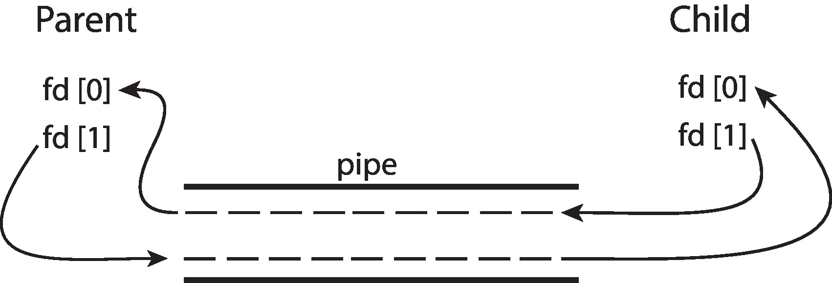
Pipes
A pipe acts as a conduit allowing two processes to communicate. Pipes were
one of the first IPC mechanisms in early UNIX systems.
Ordinary Pipes:
Ordinary pipes allow two processes to communicate in standard producer–
consumer fashion: the producer writes to one end of the pipe (the write end)
and the consumer reads from the other end (the read end).
Named Pipes:

Slide 17
First-Come, First-Served Scheduling
The process which arrives first in the ready queue is firstly assigned the CPU.
In case of a tie, process with smaller process id is executed first.
It is always non-preemptive in nature.

Slide 18
First-Come, First-Served Scheduling
Process Id Arrival time Burst time
P1 3 4
P2 5 3
P3 0 2
P4 5 1
P5 4 3
0 2 3 7 10 13 14
p3 |  | p1 | p5 | p2 | p4

Slide 19
Turn Around time = Exit time – Arrival time
Waiting time = Turn Around time – Burst time
Process Id | Exit time | Turn Around time | Waiting time
P1 | 7 | 7 – 3 = 4 | 4 – 4 = 0
P2 | 13 | 13 – 5 = 8 | 8 – 3 = 5
P3 | 2 | 2 – 0 = 2 | 2 – 2 = 0
P4 | 14 | 14 – 5 = 9 | 9 – 1 = 8
P5 | 10 | 10 – 4 = 6 | 6 – 3 = 3

Slide 20
Advantages
It is simple and easy to understand.
It can be easily implemented using queue data structure.
It does not lead to starvation.
Disadvantages:
It does not consider the priority or burst time of the processes.
It suffers from convoy effect

Slide 21
Shortest Job First:
SJF Scheduling can be used in both preemptive and non-preemptive mode.
Preemptive mode of Shortest Job First is called as Shortest Remaining Time First (SRTF).
for n processes, time complexity = nlog(n)
Critaria: Burst Time

Slide 22

Example of Shortest-remaining-time-first
Now we add the concepts of varying arrival times and preemption to the analysis
ProcessA arri Arrival TimeT Burst Time
P₁ 0 8
P₂ 1 4
P₃ 2 9
P₄ 3 5
Preemptive SJF Gantt Chart
Average waiting time = [(10-1)+(1-1)+(17-2)+(5-3)]/4 = 26/4 = 6.5 msec

Slide 23
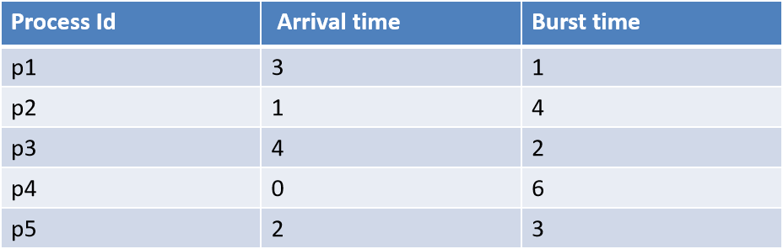
Shortest Job First:
Preemptive mode of Shortest Job First is called as Shortest Remaining Time First (SRTF); Mood : 1
0 1 2 3 4 5 6 7 8 9 10 11 12 13 16
p4 | p2 | p2 | p1 | p2 | p2 | p3 | p3 | p5 | p5 | p5 | p4 | p4 | p4
0 1 3 4 6 8 11 16
p4 | p2 | p1 | p2 | p3 | p5 | p4

Slide 24
Shortest Job First:
Advantages
SRTF is optimal and guarantees the minimum average waiting time.
It provides a standard for other algorithms since no other algorithm performs better than it.
Disadvantages
It can not be implemented practically since burst time of the processes can not be known in advance.
It leads to starvation for processes with larger burst time.
Priorities can not be set for the processes.
Processes with larger burst time have poor response time.

Slide 25
Round Robin Scheduling:
CPU is assigned to the process on the basis of FCFS for a fixed amount of time.
This fixed amount of time is called as time quantum or time slice.
After the time quantum expires, the running process is preempted and sent to the ready queue.
Then, the processor is assigned to the next arrived process.
higher value of time quantum is better in terms of number of context switch
smaller value of time quantum is better in terms of response time

Slide 26
Round-Robin Scheduling:
time quantum = 2 unit
Process Id | Arrival time | Burst time
p1 | 0 | 4
p2 | 1 | 5
p3 | 2 | 2
p4 | 3 | 1
p5 | 4 | 6
p6 | 6 | 3
Ready Queue:
P1, P2, P3, P1, P4, P5, P2, P6, P5, P2, P6, P5
0 2 4 6 8 9 11 13 15 17 18 19 21
p1 | p2 | p3 | p1 | p4 | p5 | p2 | p6 | p5 | p2 | p6 | p5

Slide 27
Round Robin Scheduling:
Advantages
It gives the best performance in terms of average response time.
It is best suited for time sharing system, client server architecture and interactive system.
Disadvantages
It leads to starvation for processes with larger burst time as they have to repeat the cycle many times.
Its performance heavily depends on time quantum.
Priorities can not be set for the processes.

Slide 28
Priority Scheduling:
Out of all the available processes, CPU is assigned to the process having the highest priority.
In case of a tie, it is broken by FCFS Scheduling.
Priority Scheduling can be used in both preemptive and non-preemptive mode.
Priority scheduling in preemptive mode is best suited for real time operating system.

Slide 29
Important Note:
The waiting time for the process having the highest priority will always be zero in preemptive mode.
The waiting time for the process having the highest priority may not be zero in non-preemptive mode.
Priority scheduling in preemptive and non-preemptive mode behaves exactly same under following conditions
The arrival time of all the processes is same
All the processes become available

Slide 30
Priority Scheduling:
Higher number represents higher priority
Process Id | Arrival time | Burst time | Priority
p1 | 0 | 4 | 2
p2 | 1 | 3 | 3
p3 | 2 | 1 | 4
p4 | 3 | 5 | 5
p5 | 4 | 2 | 5
0 4 9 11 12 15
p1 | p4 | p5 | p3 | p2

Slide 31
Priority Scheduling:
Advantages
It considers the priority of the processes and allows the important processes to run first.
Priority scheduling in preemptive mode is best suited for real time operating system.
Disadvantages
Processes with lesser priority may starve for CPU.
There is no idea of response time and waiting time.

Slide 32
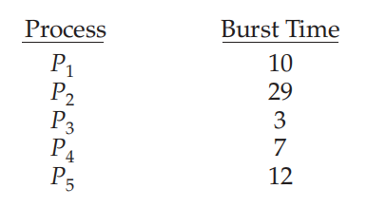
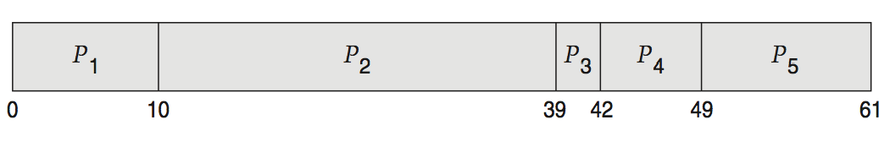
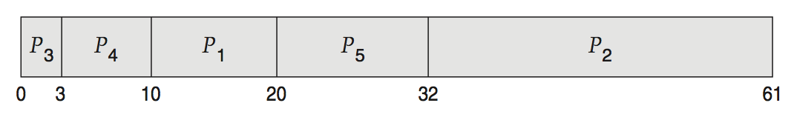
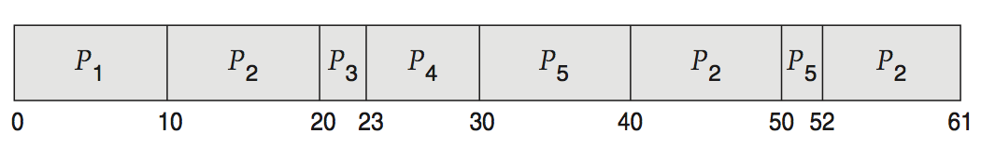
Deterministic Evaluation:
For each algorithm, calculate minimum average waiting time
Simple and fast, but requires exact numbers for input, applies only to those inputs
  FCS is 28ms:
Average waiting time: (0+10+39+42+49)/5= 28 ms
  Non-preemptive SFJ is 13ms:
Average waiting time: (10+32+0+3+20)/5= 13 ms
  RR is 23ms:(preemptive )
Average waiting time: (0+32+20+23+40)/5= 23 ms

Slide 33
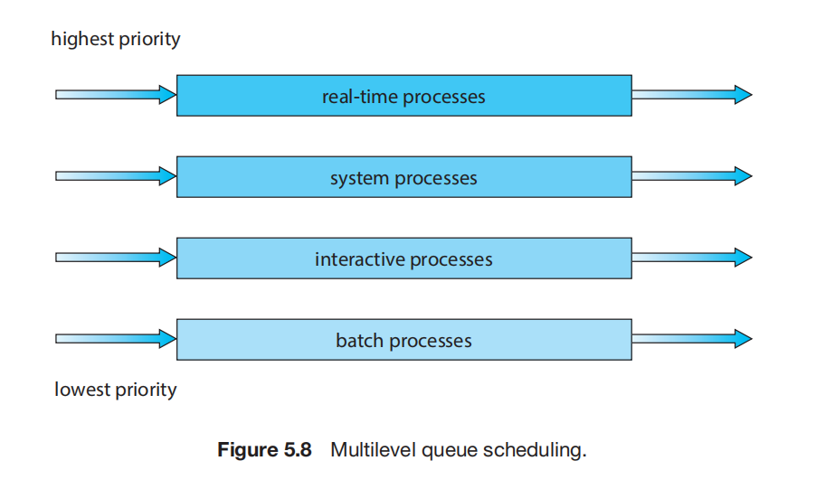
Multilevel Queue Scheduling:
Problem called Starvation

Slide 34
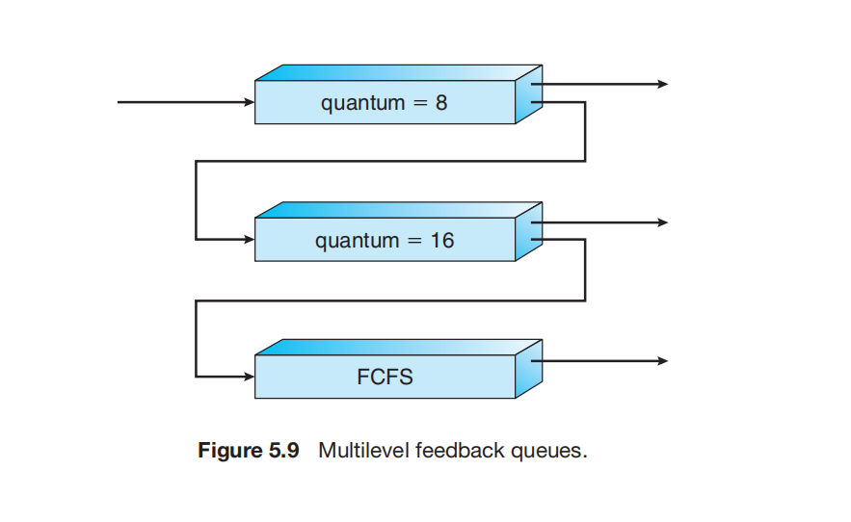
Multilevel Feedback Queue Scheduling

Slide 35
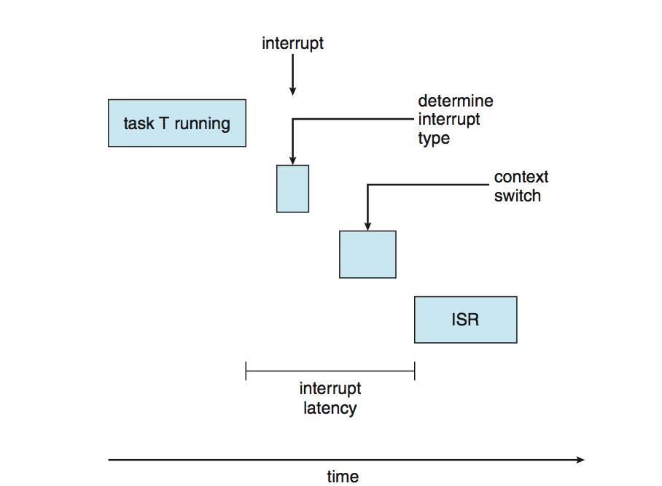
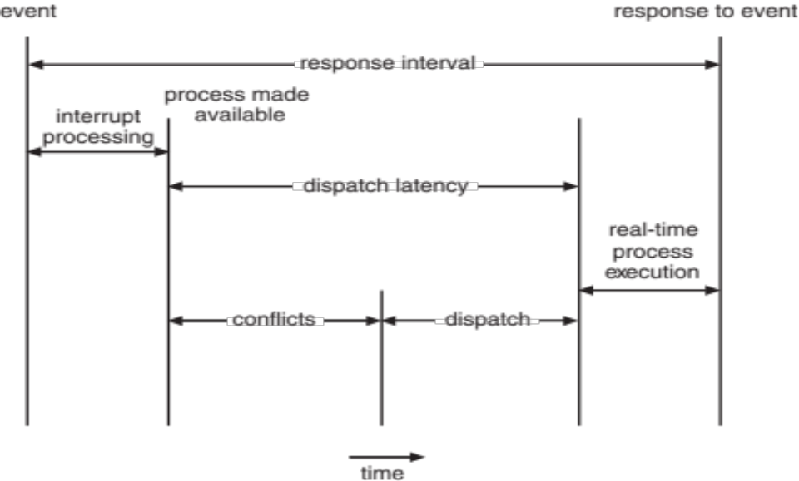
Real-Time CPU Scheduling:
Two types of latencies affect the performance of real-time systems:
  Interrupt latency : time from arrival of interrupt to start of routine that services interrupt
  Dispatch latency –:time for schedule to take current process off CPU and switch to another

Slide 36
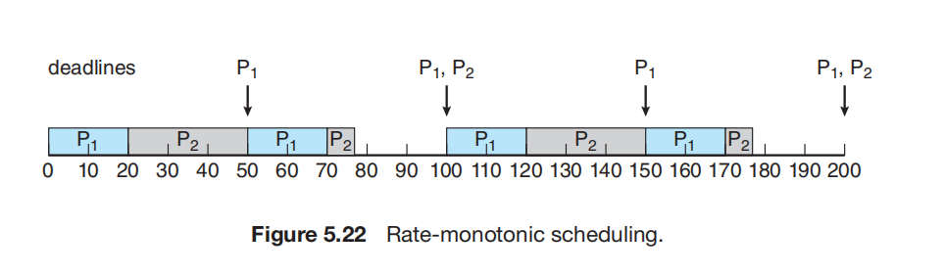
Rate-Monotonic Scheduling
A priority is assigned based on the inverse of its period
Shorter periods = higher priority;
Longer periods = lower priority
P₁ is assigned a higher priority than P₂
Example:
p1 = 50 and p2 = 100.
The processing times are t1 = 20 for P1 and t2 = 35 for P2.

Slide 37
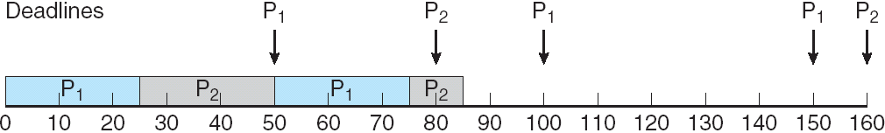
Missed Deadlines with Rate Monotonic Scheduling
Example:
p1 = 50 and p2 =80.
The processing times are t1 = 25 for P1 and t2 = 35 for P2.

Slide 38
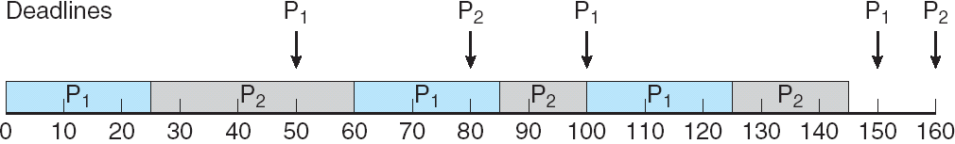
Earliest Deadline First Scheduling (EDF)
Priorities are assigned according to deadlines:
**The earlier the deadline, the higher the priority;
the later the deadline, the lower the priority
Example:
p1 = 50 and p2 =80.
The processing times are t1 = 25 for P1 and t2 = 35 for P2.

Slide 39
Proportional Share Scheduling
POSIX Real-Time Scheduling

